Slide 1
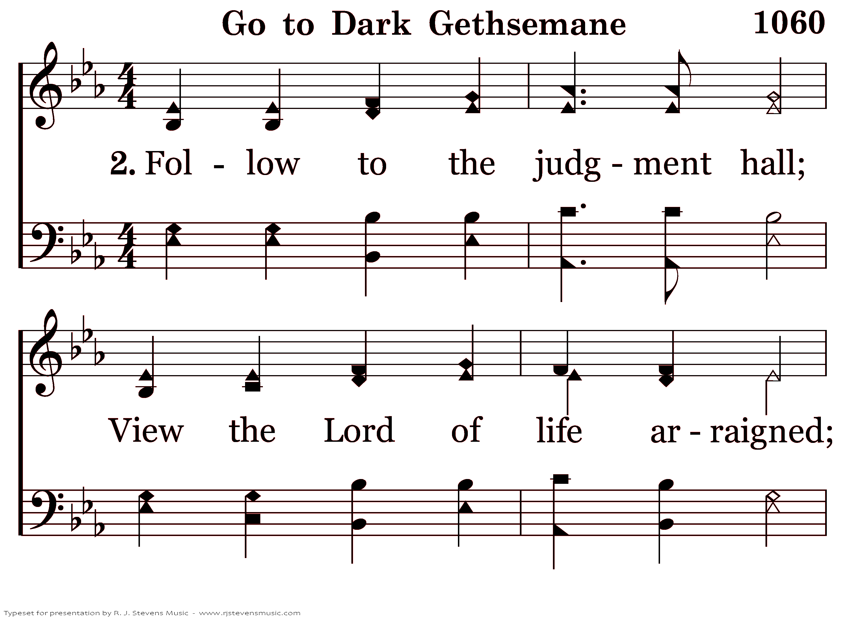
21060 - GO TO DARK GETHSEMANE - VERSE 2.0.png

Slide 2
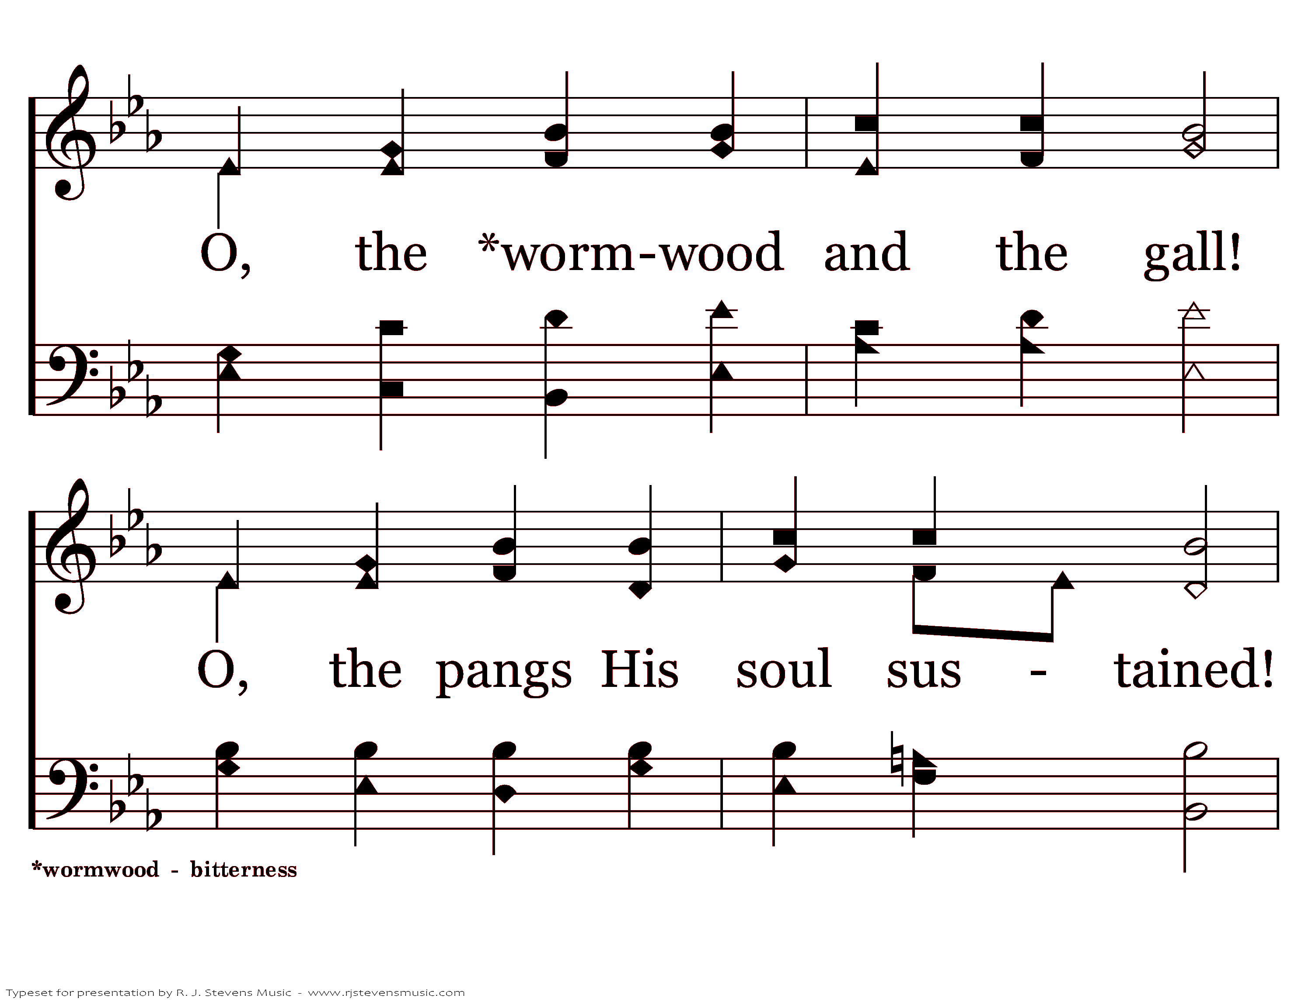
21060 - GO TO DARK GETHSEMANE - VERSE 2.1.png

Slide 3
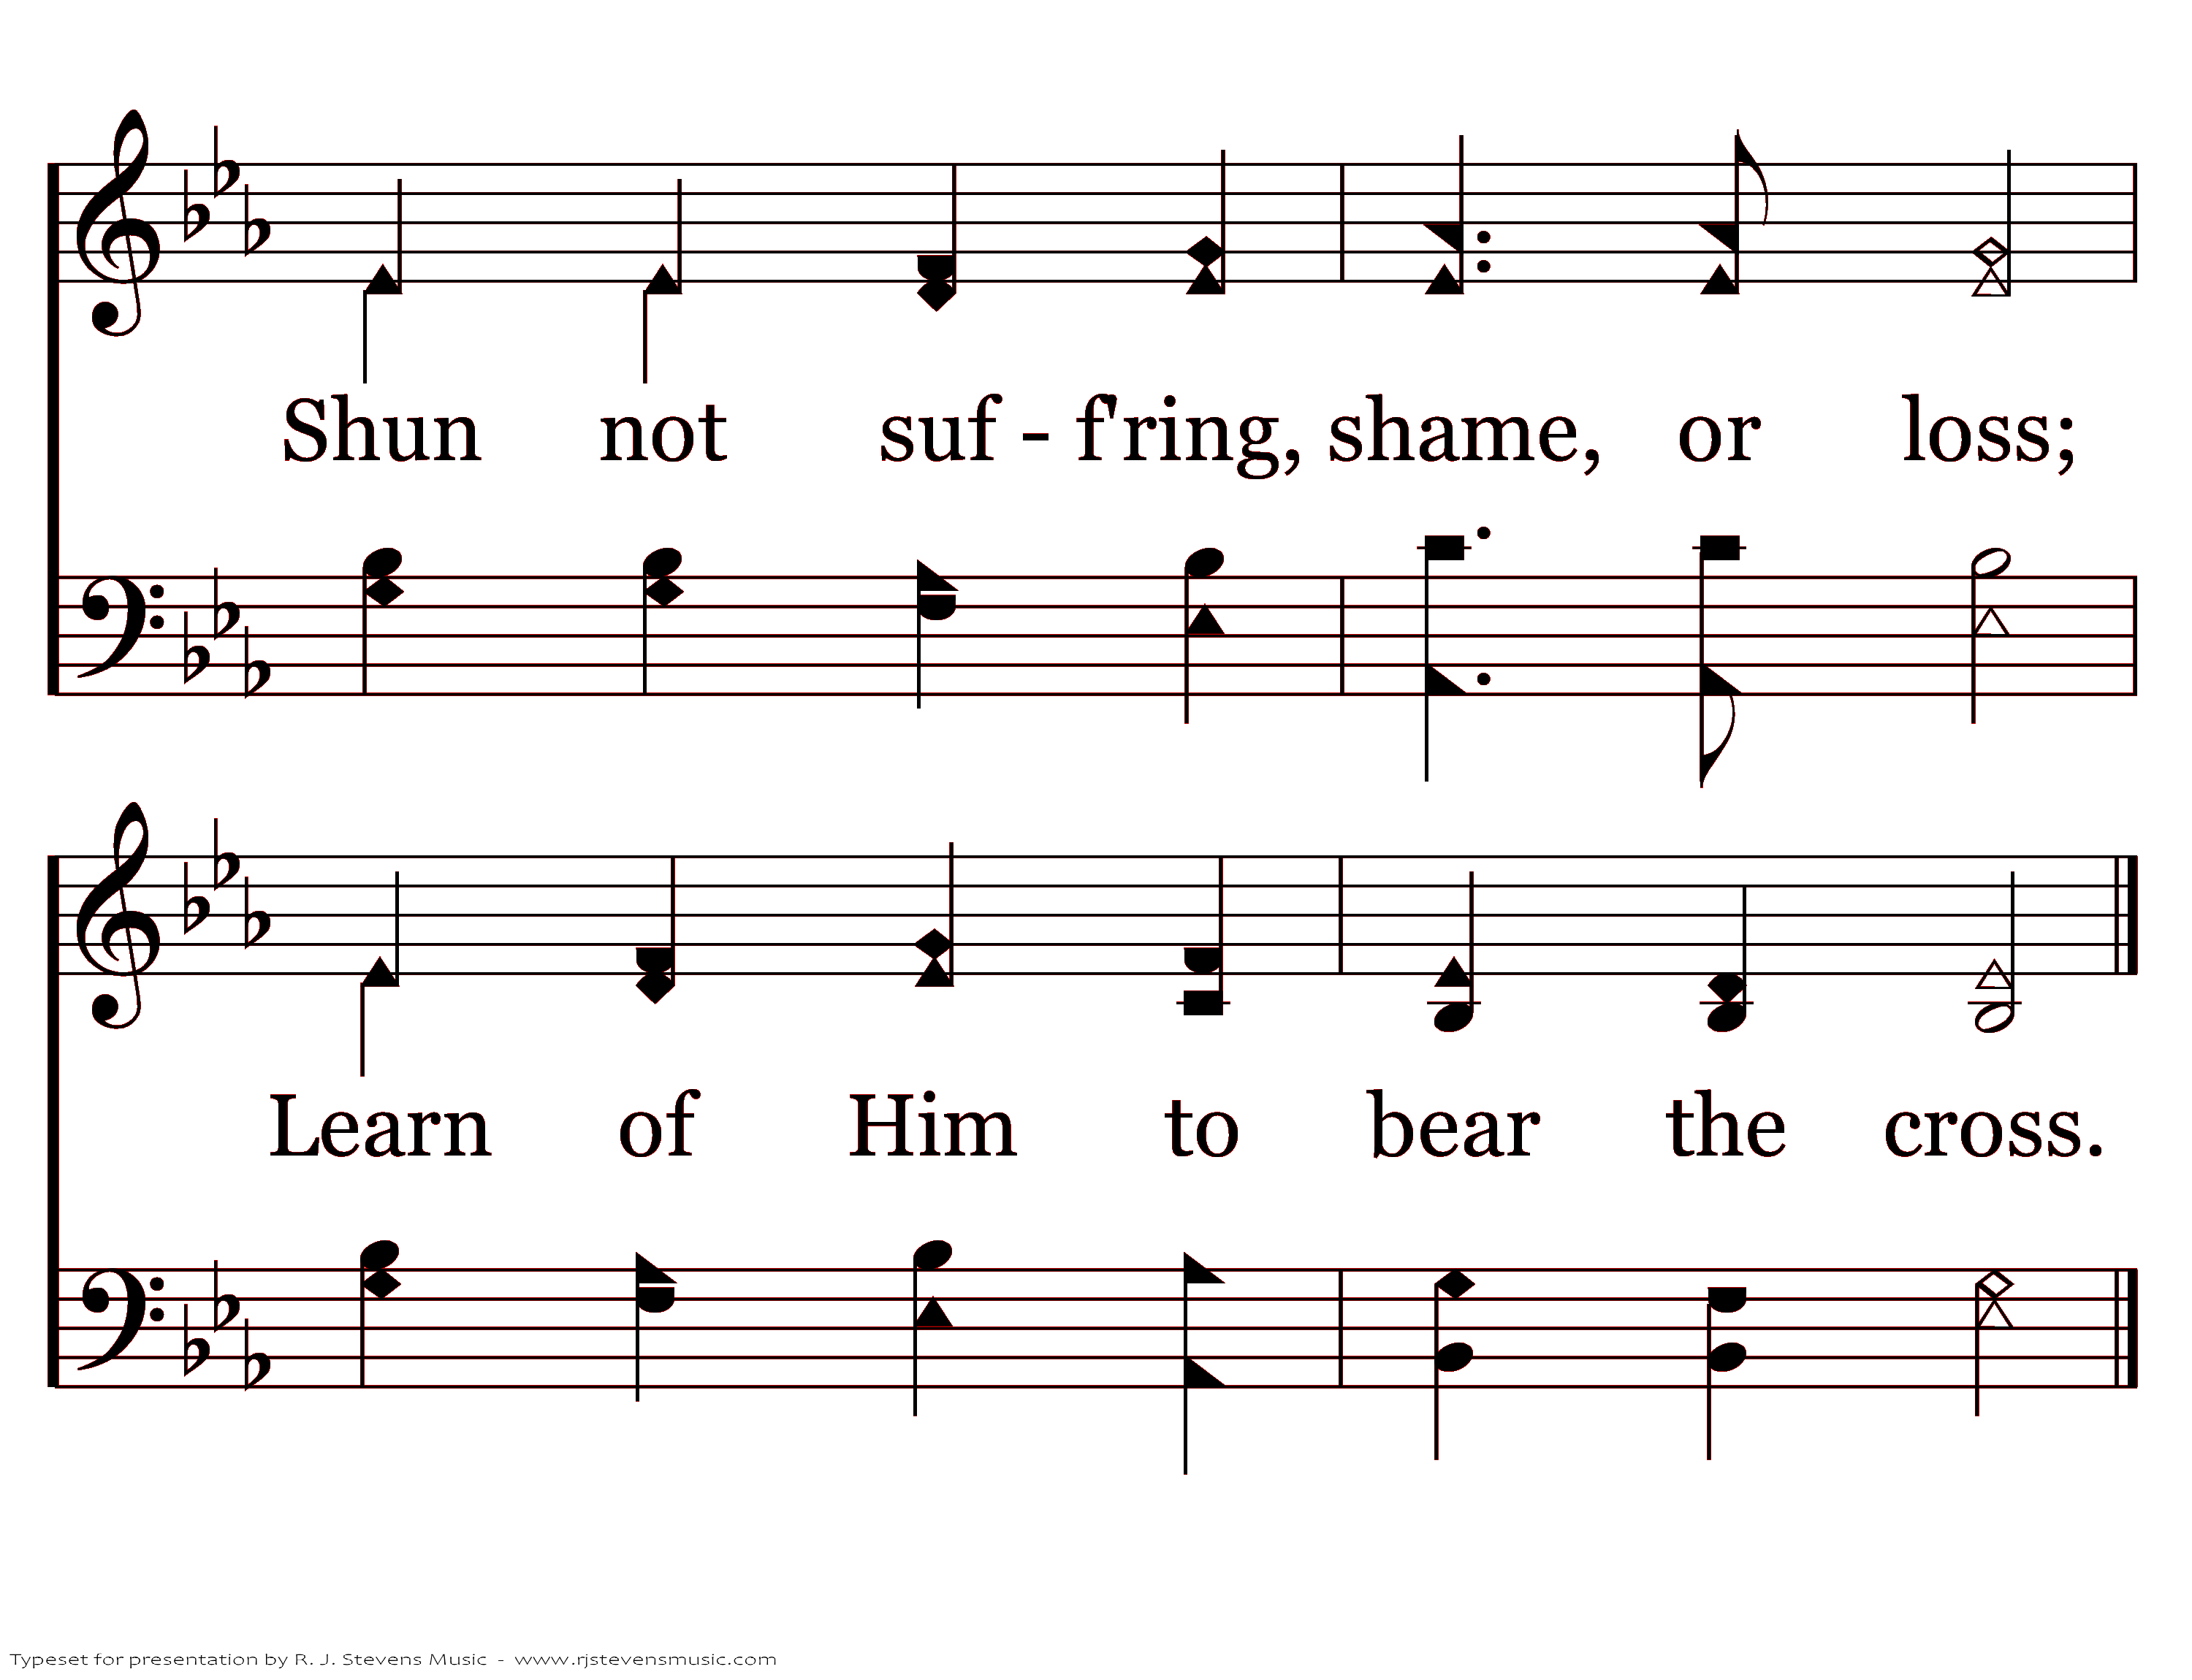
21060 - GO TO DARK GETHSEMANE - VERSE 2.2.png

